Slide 1

A Robust Heart Disease Prediction System Using Hybrid Deep Neural Networks
Authors: Muhammad Ali Zeb ,Mana Saleh Al Reshan, Samina Amin, Adel Sulaiman, Hani Alshahrani, Asadullah Shaikh
Published in: IEEE Access,
Date of Publication: 31 October 2023
- Santhosh kumar Katta 700757502
click to open github repo

Slide 2

introduction
Goal: Reproduce the IEEE experiment on A Robust Heart Disease Prediction System Using Hybrid Deep Neural Networks
Motivation: Early detection improves patient outcomes
Tools Used: Python, Pytorch, Jupyter Notebook.

Slide 3

architecture summary
Layers: Convolutional + LSTM Layer + Dense Blocks
Dataset Used: Publicly available dataset

Slide 4

Code Implementation Overview
Environment: Jupyter Notebbok
Framework: Pytorch
Key Functions: Preprocessing, Model definition, training, evaluation
Challenges: Dataset matching, environment setup

Slide 5
ResUlts/Findings
Enhancing The hybrid DNN model achieved:
Higher accuracy compared to traditional models.
Lower false positive rates.
Better feature representation and classification performance.
Demonstrated robustness across different datasets.

Slide 6
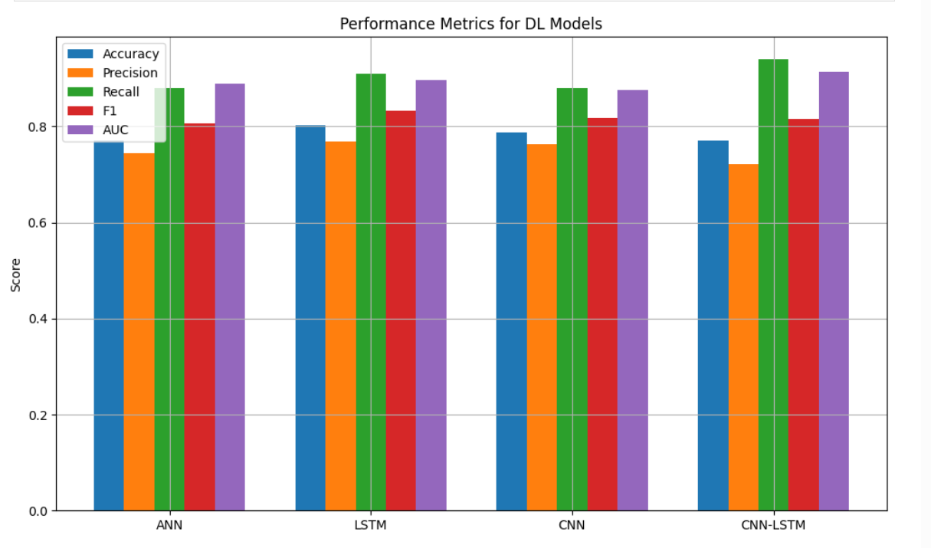
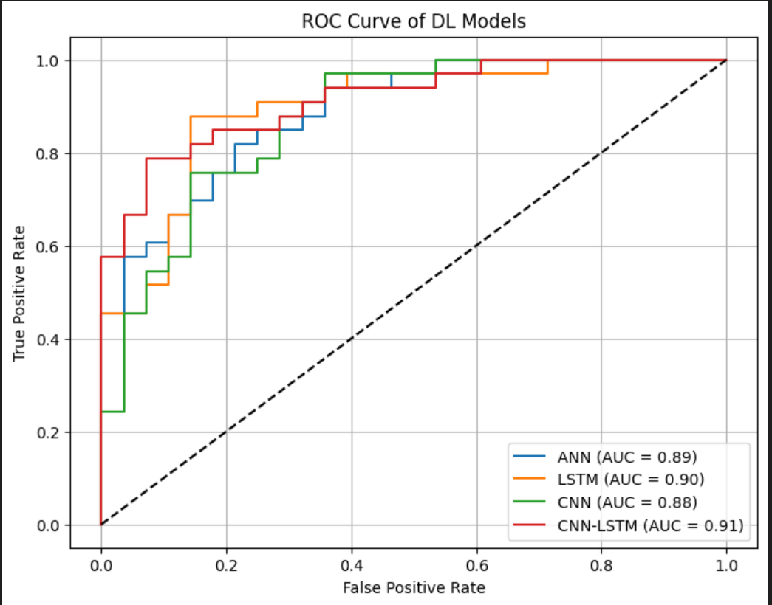
GRAPHS

Slide 7
IMPROVEMENTS MADE
Fine-tuned hyperparameter
Added machine learning models to get desired outcome.
Adjusted training epochs and batch size
Used Pytorch. It is a flexible and powerful framework.

Slide 8
CHALLENGES FACED
Dataset finding
Compatibility issues with TensorFlow Addons so I have used Pytorch.
Workaround: Switched to supported versions

Slide 9

THANK YOU

